Slide 1

CodeX Marketing Insights
CodeBasics Resume Project Challenge – 6
By Karthikraj Sooraj J
Dated 25.08.2023

Slide 2
Content
Introduction
Plan of Action
Task
Primary Insights
Secondary Insights
Summary

Slide 3
Introduction
CodeX, a German beverage company recently launched its energy drink in 10 cities in India and is aiming to make its mark in the Indian market.
The Marketing team's objectives include increasing brand awareness, market share and product development.
To gather insights, a survey was conducted in the 10 cities generating responses from 10,000 respondents.
The aim is to provide meaningful insights and recommendations that align with CodeX's goals and drive success in the Indian market.

Slide 4
Plan of Action
Increase Awareness: Enhance advertising, social media, and PR efforts to boost Codex energy drink's visibility among the target audience.
Expand Distribution: Forge partnerships with retailers and distributors for wider availability of Codex energy drink.
Promotional Campaigns: Offer attractive discounts and promotions to entice consumers to try Codex.
Product Innovation: Introduce new flavors and innovative packaging to cater to diverse consumer preferences.
Market Research: Regularly conduct market research to track performance, gather feedback, and identify growth opportunities.

Slide 5
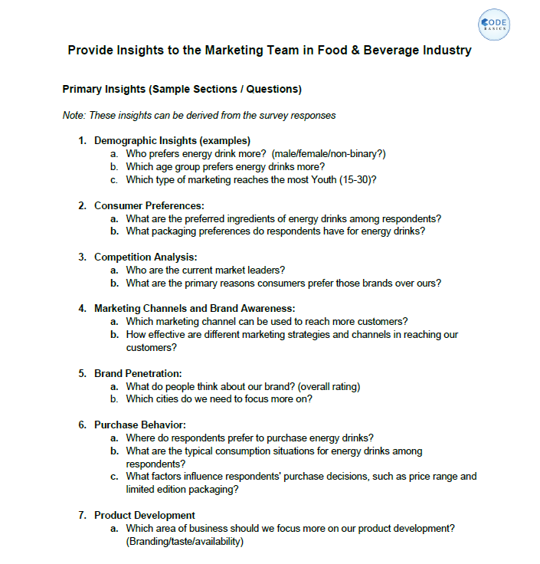
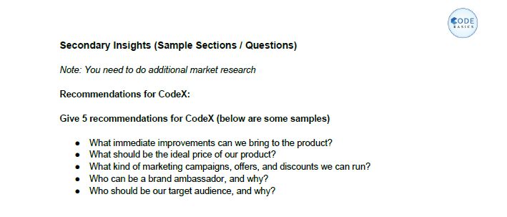
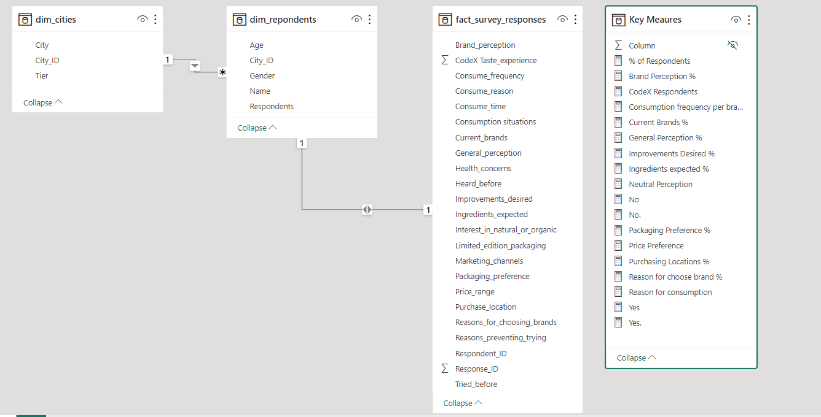
Task The task is to extract meaningful insights that can guide actionable strategies and decisions for the Marketing team and present it to the Chief Marketing Officer.

Slide 6
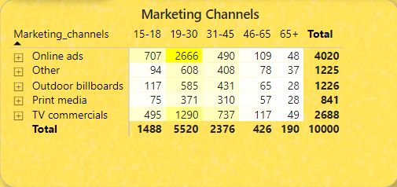
Demographic Insights
a. Who prefers energy drink more? (male/female/non-binary?)
b. Which age group prefers energy drinks more?
c. Which type of marketing reaches the most Youth (15-30)?
a.
b.
c.

Slide 7
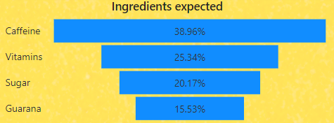
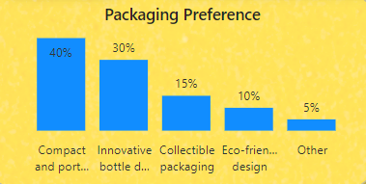
Consumer Preferences
a. What are the preferred ingredients of energy drinks among respondents?
b. What packaging preferences do respondents have for energy drinks?
a.
b.

Slide 8
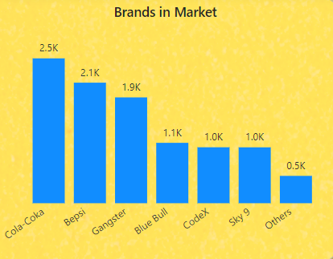
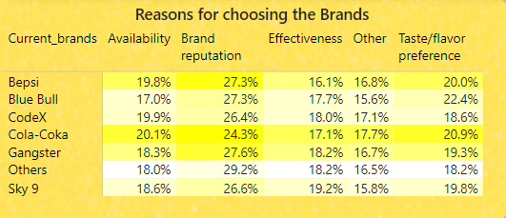
Competition Analysis
a. Who are the current market leaders?
b. What are the primary reasons consumers prefer those brands over ours?
a.
b.

Slide 9
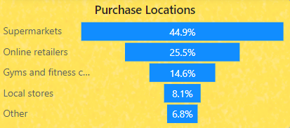
Marketing Channels and Brand Awareness
a. Which marketing channel can be used to reach more customers?
b. How effective are different marketing strategies and channels in reaching our customers?
a.
b.

Slide 10
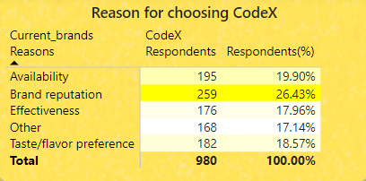
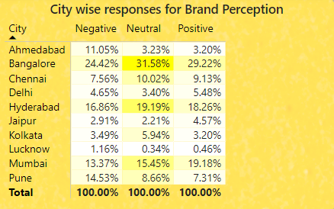
Brand Penetration
a. What do people think about our brand? (overall rating)
b. Which cities do we need to focus more on?
a.
b.

Slide 11
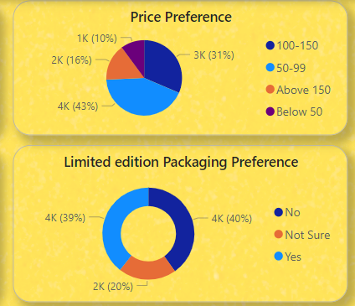
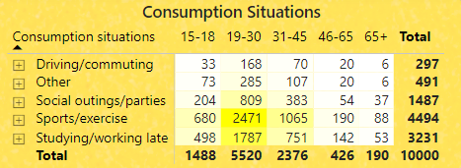
Purchase Behavior
a. Where do respondents prefer to purchase energy drinks?
b. What are the typical consumption situations for energy drinks among respondents?
c. What factors influence respondents' purchase decisions, such as price range and limited edition packaging?
a.
c.
b.
c.

Slide 12


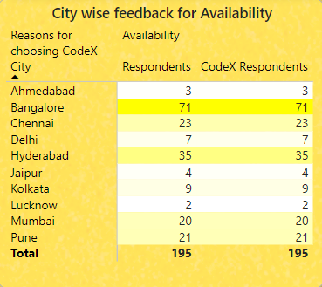
Product Development a. Which area of business should we focus more on our product development? (Branding/taste/availability)
Out of 980 respondents of CodeX, only 219 have a positive brand perception.
We need to work on the availability of the product. About 20% of the consumers choose the product because it is available. Availability is a major factor in sales of a product.
The taste experience rating is the same as the industry rating. This is not something that needs immediate attention.

Slide 13
Recommendations for CodeX
What immediate improvements can we bring to the product?
What should be the ideal price of our product?
What kind of marketing campaigns, offers, and discounts we can run?
Who can be a brand ambassador, and why?
Who should be our target audience, and why?

Slide 14
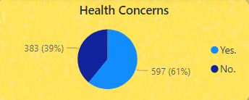
What immediate improvements can we bring to the product?
Availability
Health Concern – If possible another survey related to health concern questions.
Limited Edition Packaging
Add more natural ingredients, reduce sugar content and add more flavours.
Improve positive response rate

Slide 15
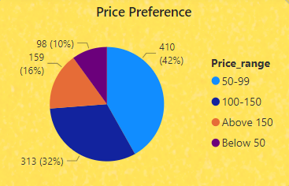
What should be the ideal price of our product?
The price range expected by consumers lies between 50 to 150.
In cities like Ahmedabad, Chennai, Hyderabad, Kolkata, Lucknow, Mumbai, and Pune consumers expect the price range to be between 50 to 99.
While in the rest of the cities, people are willing to pay up to 150.

Slide 16
What kind of marketing campaigns, offers and discounts we can run?
Marketing Campaigns
Social Media
Influencer Marketing
Online Retailers/E-commerce
Offers/Discounts
In the previous recommendation, we saw that we can experiment with the price in different cities. Also, if changing the price does not go with the brand’s strategy, we can provide offers on buying the pack of 6 cans at a cheaper cost.
Also, each of these cities celebrates multiple festivals throughout the year. We can come up with the gift set packs.

Slide 17
Social Media and Online Retailers/E-commerce
We have seen in the insights that our consumers fall in the age group of 15 to 30. This age group is very much active on social media. Also, they get to know about the products from online ads. Running Social Media Ads can be a good strategy to reach them.
E-commerce and online grocery store do have their own PPC platforms. We can run paid ads on these platforms to increase the sale of the product because we are still not as well known by the consumers as the other brands.

Slide 18
Influencer Marketing
Cheap Influencer marketing can be very cheap we set a strategy to target influencers and their audiences. We can work on a barter system or by paying some amount to the influencers.
Collaborating with local influencers (multiple Macro & Micro) We can collaborate with the influencers with the following of 10k to 100k, then 100k to 500k and so on. This will help our brand with branding and sales.
Giveaway to Influencers and their Followers Providing our products to consumers via influencers can help in changing brand perception.
Exclusive Coupons and Discounts Providing these discount coupons and exclusive offers will help us in retaining our customers. This will also play a role in remarketing by not spending money again and again on these campaigns.

Slide 19
Who can be a brand ambassador, and why?
While choosing the influencers, we need to keep in mind that we have to consider certain factors in mind. 1. Budget – Celebrity influencers charge more money according to their following and impact on social media. 2. Relevancy – Energy drinks are consumed by consumers who like to do some sort of physical activity. So, the celebrity should be a sportsperson, athlete or person indulged in some physical activity. 3. Impact – It is important to have an impact on their followers. Not every celebrity is influential but can still be followed by a vast audience. A celebrity who can influence the buying decision needs to be our brand ambassador.
I have suggested Virat Kohli as our brand ambassador.

Slide 20

Virat Kohli
Virat Kohli, the iconic Indian cricketer and former captain of the Indian cricket team, has taken the brand endorsement world by storm.
With exceptional talent and a magnetic personality, Kohli is the top choice for numerous renowned brands.
Notably, he was the only cricketer on Forbes magazine's list of the top 100 highest-paid athletes in 2020.
His substantial earnings of approximately Rs 175 crore from brand endorsements set records in both the Bollywood and sports industries.

Slide 21
Who should be our target audience, and why?
It is evident from the statistics that our consumers are mostly between the ages of 15 to 30.
From this survey, the count shows that 70% of consumers are youth.

Slide 22
Summary
We need to focus on online marketing strategy change.These stats shows that we can reach consumers via online ads,but it also shows that most of the buyers purchasing the products from supermarket also.
Improving the taste – Changing ingredients will change the taste.
Changing Brand’s Perception by doing more branding via online Ads.

Slide 23


